Slide 1
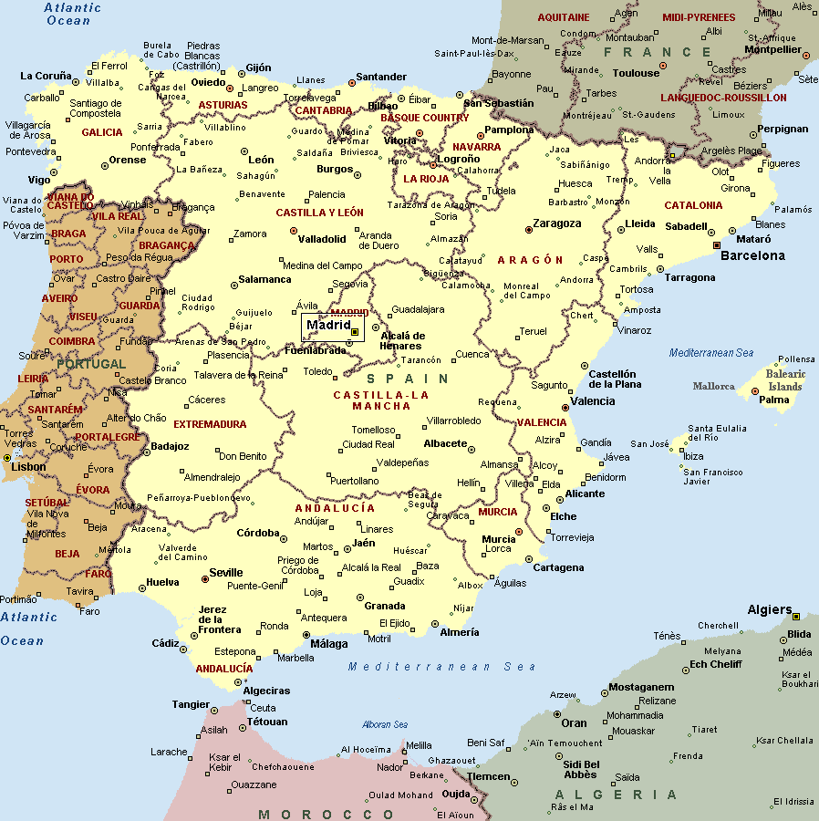
Segovia, Spain
Is located about 50 miles northwest of Madrid
Slightly larger that York in population
Phrase “Pigging out” started here

Slide 2
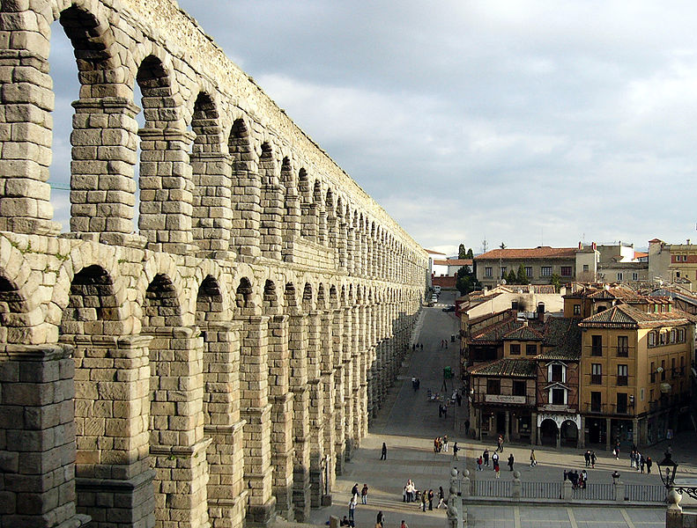
Aqueduct of Segovia
Constructed by the Romans around the end of the 1st century
Carries water from mountains 11 miles away
Its highest point more than 93 feet
No mortar was used

Slide 3
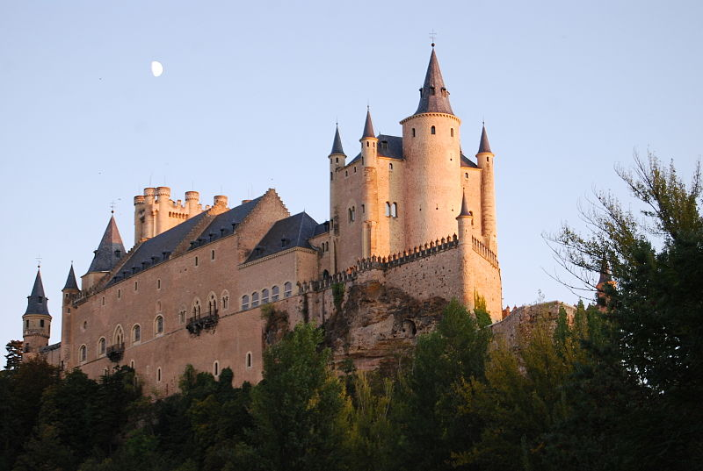
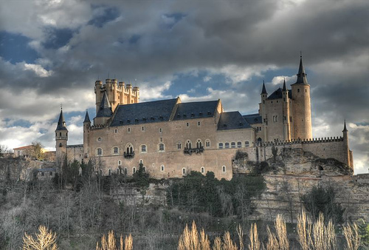
Alcazar of Segovia
Was constructed around 1200 A.D.
Built in the form of a bow of a ship
Originally built as a fortress but has served as a royal palace, a state prison, a Royal Artillery College and a military academy since then

Slide 4
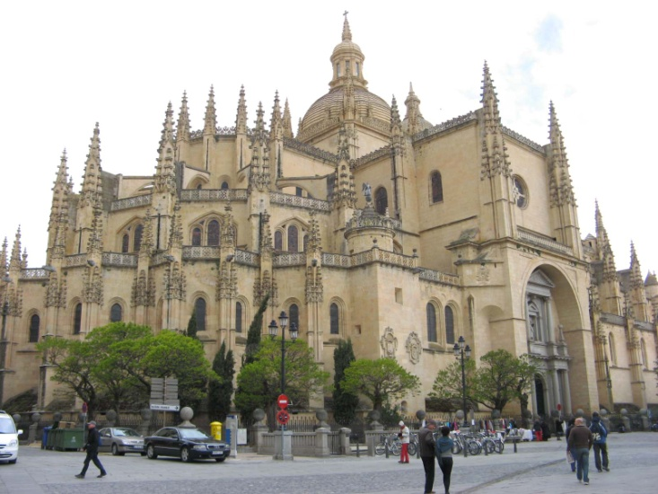
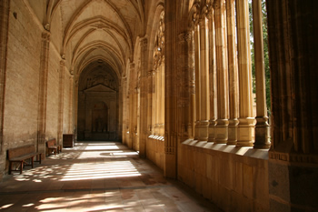
Segovia Cathedral
Started in 1525 but not finished until 1768
Considered to be the last major Gothic building in Spain
Located at the main plaza of the town
Has more than 20 chapels
Contains a small museum of religious art

Slide 5
Resources
Websites:
Alcazar of Segovia." Wikipedia. Wikipedia, n.d. Web. 1 Sept. 2011. <http://en.wikipedia.org/wiki/Alcazar_of_Segovia>.
Aqueduct of Segovia." Wikipedia. Wikipedia, n.d. Web. 1 Sept. 2011. <http://en.wikipedia.org/wiki/Aqueduct_of_Segovia>.
Segovia." Wikipedia. Wikipedia, n.d. Web. 1 Sept. 2011. <http://en.wikipedia.org/wiki/Segovia>.
Segovia Cathedral." Wikipedia. Wikipedia, n.d. Web. 1 Sept. 2011. <http://en.wikipedia.org/wiki/Segovia_Cathedral>.
Spain Guide: Segovia Cathedral." Rough Guides. Rough Guides, n.d. Web. 1 Sept. 2011. Path: http://www.roughguides.com/travel/europe/spain/around-madrid/segovia/segovia-cathedral.aspx.
Books:
LaBalle, Candy. Moon Spain. Emeryville, CA: Avalon Travel Publishing, 2007. Print.

